Slide 1
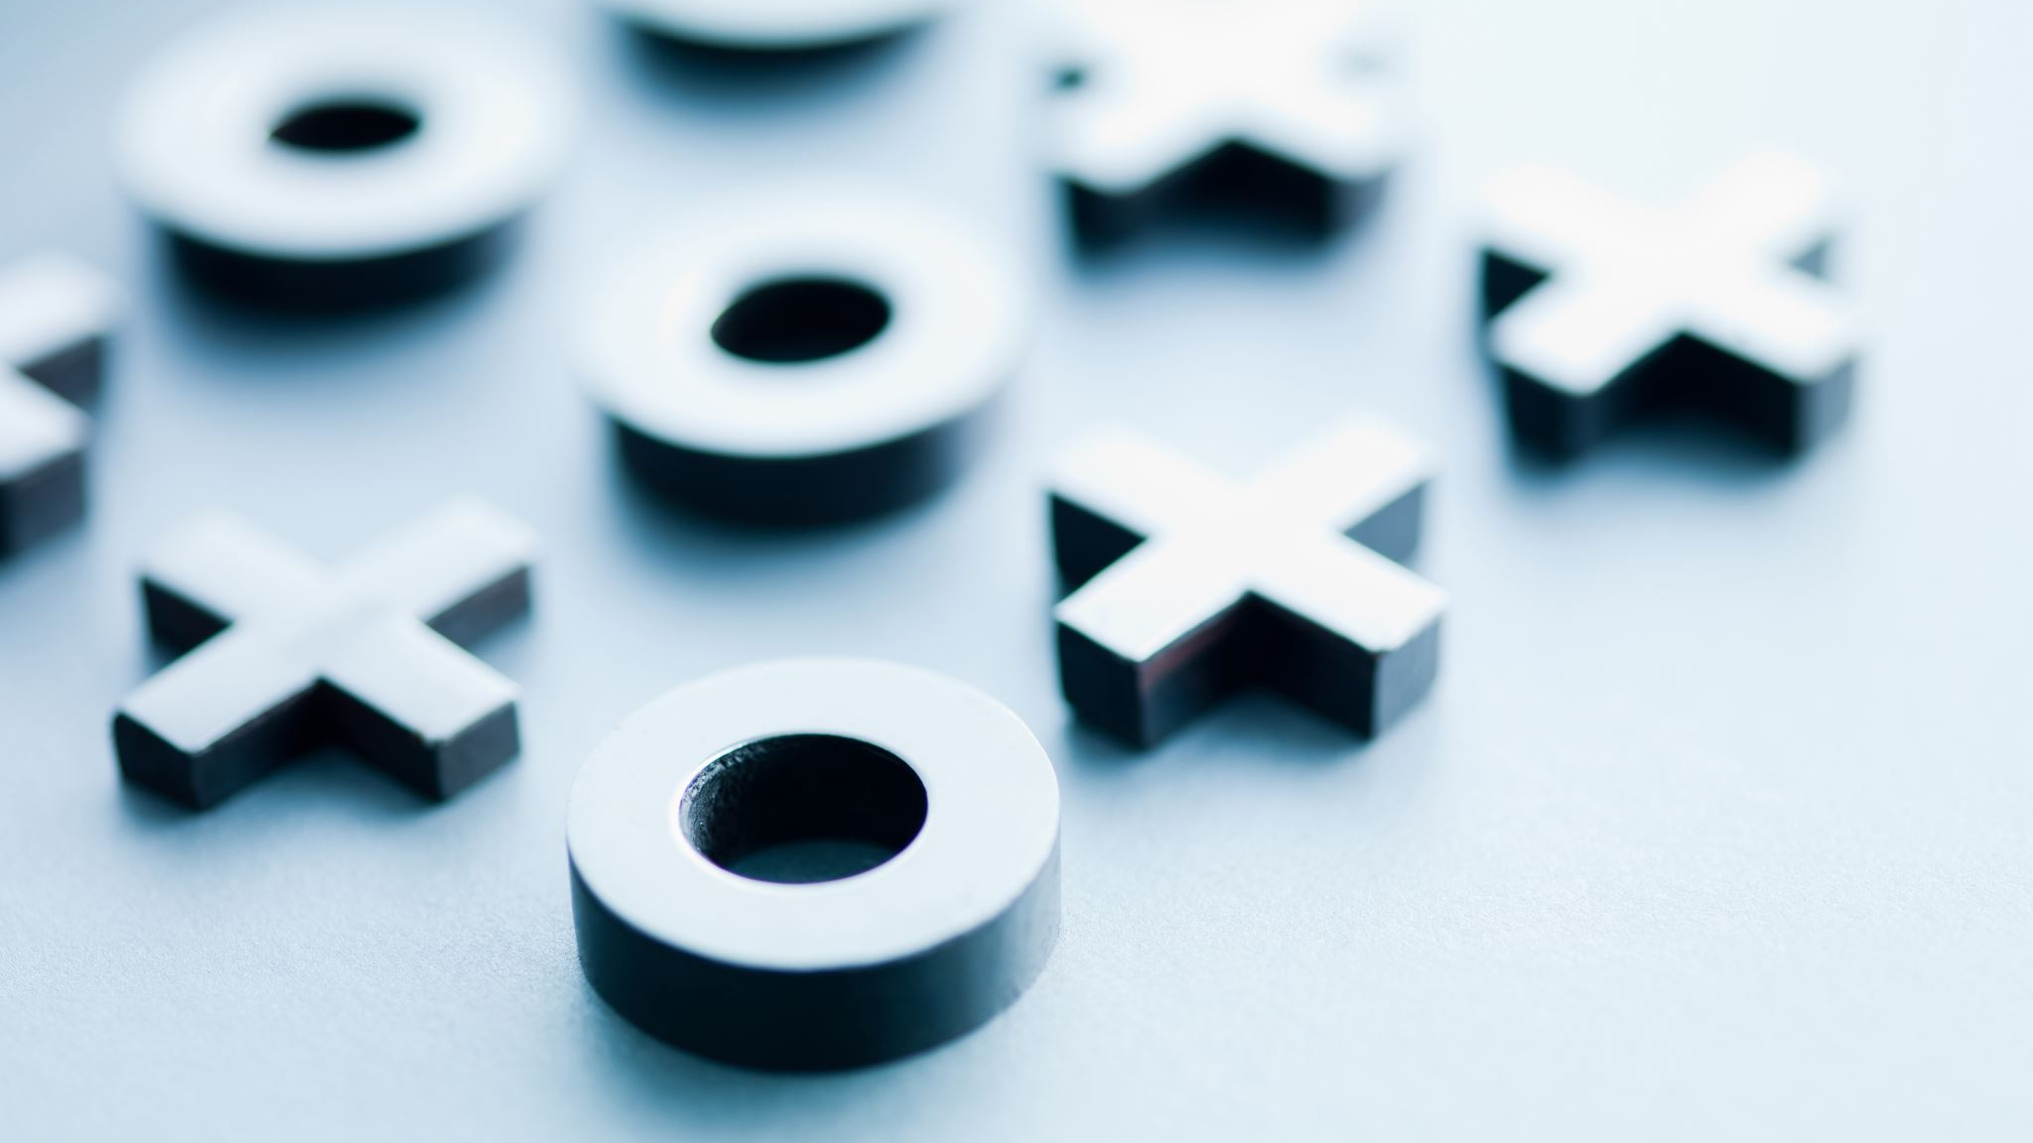
OKCupid and Astrology Signs
Final Project

Slide 2
Our Team
Kesley Richards
Nigan Martin
Patrycja Pekala
Yanqiu (Doris) Yang
Jessica Ferraro

Slide 3
Rationale

Slide 4
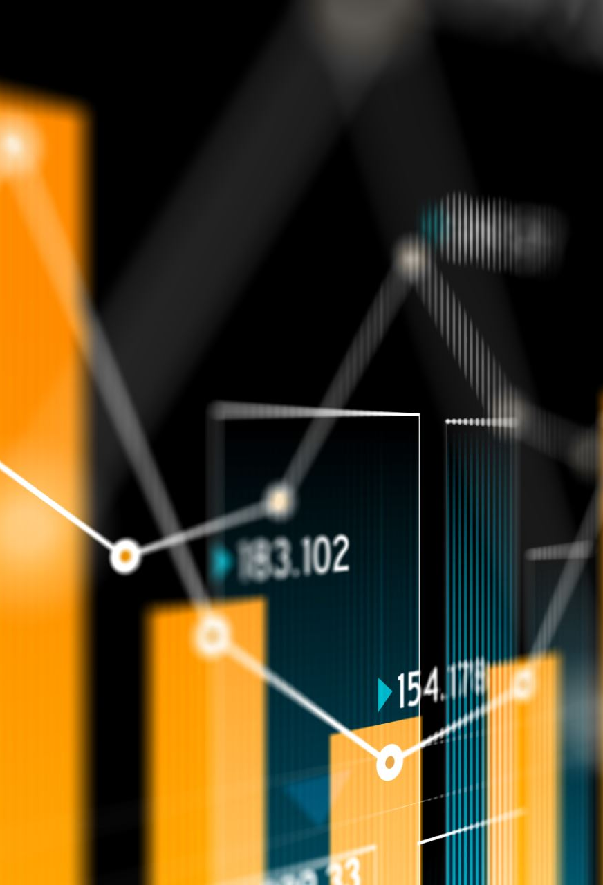
The data

Slide 5

Potential Further Projects
Can machine learning predict how many dates a user will get?
Can machine learning predict if a user will meet their “soulmate”?

